Slide 1
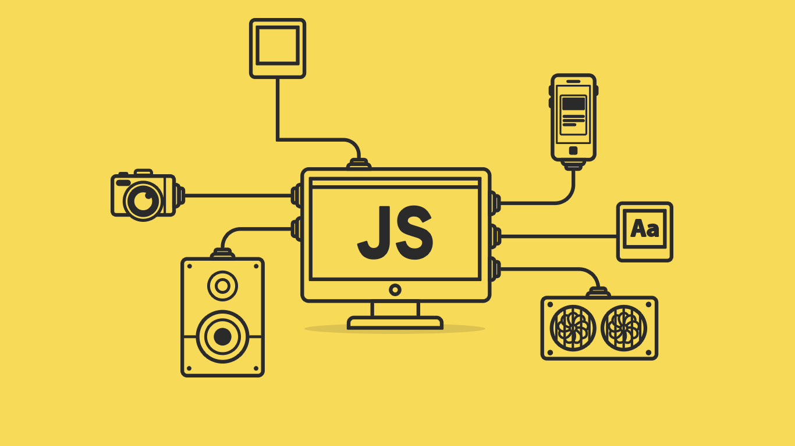

Slide 2
About today…
Document Object Model
Types of events
Event listeners
Event handling

Slide 3
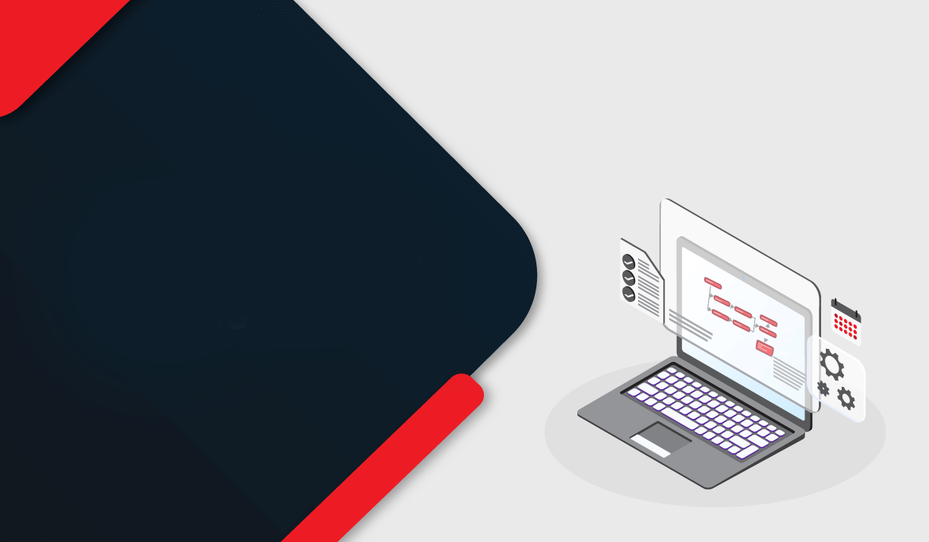
Introduction
to Event Handling

Slide 4
Understanding Event Handling
Event handling is like
setting up a system
that listens for / responds to
user actions on a web page
making the website interactive and dynamic

Slide 5
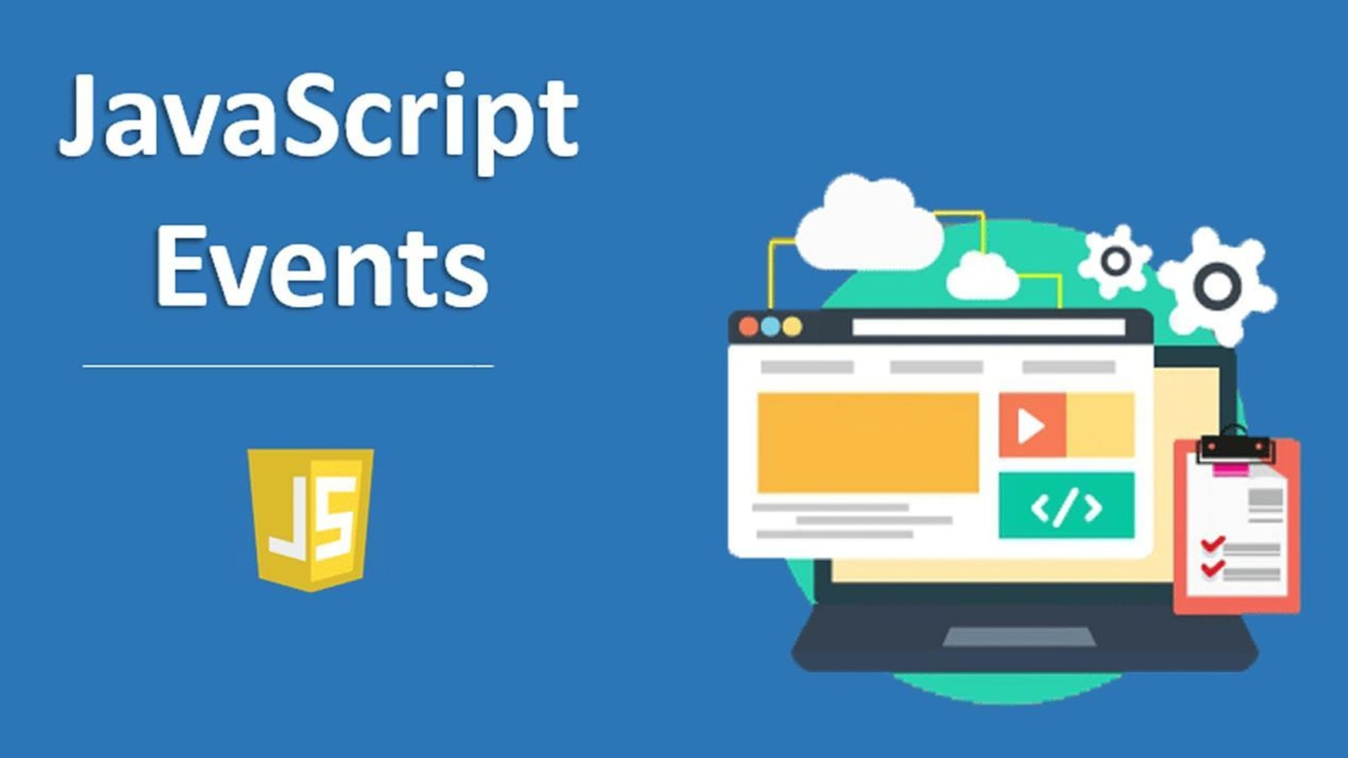

Slide 6
Types of Events
User Events
System Events
Click Events
Load Events
Mouse Events
Resize Events
Keyboard Events
Scroll Events
Form Events

Slide 7
User Events
Click Events
When a user clicks a button, submits a form, or interacts with clickable elements
Mouse Events
Example
Actions like moving the mouse, hovering over elements, or scrolling through a webpage
Clicking a "Like" button on a social media post
Example
Changing the color of a button when the mouse hovers over it
Keyboard Events
Reacting to keyboard inputs such as typing, pressing keys, or entering data
Form Events
Example
Events related to form interactions like submitting, resetting, or validating inputs
Pressing the "Enter" key to submit a search form
Example
Showing an error message if a required field is left empty

Slide 8
System Events
Load Events
Triggers when a webpage or a resource finishes loading
Example
Scroll Events
Displaying a welcome message when the page loads completely
Triggered when scrolling up or down on a webpage
Example
Resize Events
Lazy loading images as the user scrolls down the page
Occurs when the browser window is resized
Example
Adjusting the layout of a responsive website based on window size changes

Slide 9
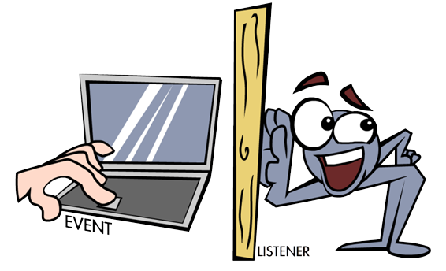
Event Listeners
Event Listeners are like attentive listeners waiting for specific actions to occur.
Allow us to handle user interactions in our code
Example
A "click" event listener on a button executes a function when the button is clicked

Slide 10

Adding Event Listeners
Adds a click event listener to an element and performs action when the event is triggered
Syntax
element.addEventListener(event, function, useCapture);
Example
This code adds a click event listener to a button with the ID "myButton" and displays an alert when clicked

Slide 11
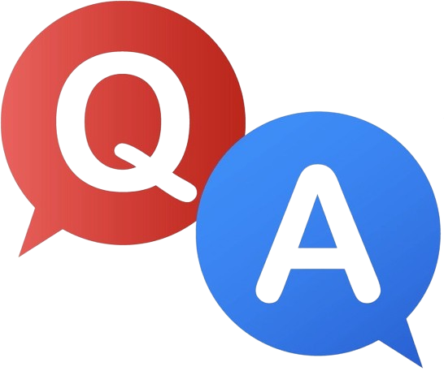

Slide 12
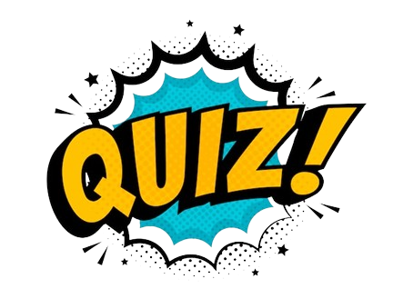
What is event handling in web development?
How can you add an event listener to a button element in JavaScript?
What is the purpose of event delegation?
Why is it important to remove event listeners when they are no longer needed?

Slide 13

Task 1
Create a button that changes its color when clicked
Task 2
Implement form validation using event listeners

